Slide 1
HISTORY OF ASTRONOMY
FROM THE ANCIENTS TO TODAY

Slide 2
WHAT DO YOU KNOW ABOUT ASTRONOMY?
Take a minute and reflect about what you know about astronomy? What do we have or use today that comes from studying space?

Slide 3
HOW WE STARTED…ANCIENT TIMES
We can’t say for sure when we started to ponder our place in the universe, but we do know that one of the first things humans did was find patterns in the stars and matched them to what was happening on earth.

Slide 4
ANCIENT TIMES
People used the seasonal cycle of stars, planets and the moon to mark passage of time, even though they had no knowledge of how the universe works. This is evident from structures such as Stonehenge or the Bighorn Medicine Wheel.

Slide 5
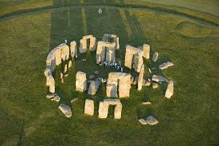
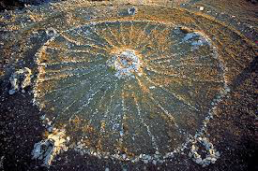
STONEHENGE AND BIGHORN MEDICINE WHEEL

Slide 6
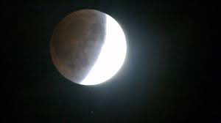
ARISTOTLE (384-322 BCE)
Aristotle suggested that Earth was round because: A) order of visibility when a ship came over horizon- mast→deck→ship, and B) he observed Earth’s shadow on the moon during a lunar eclipse

Slide 7
PTOLEMY (170 - 100 BCE)
Earth-centered universe (Geocentric)
studied how mathematics could be seen in astronomy
predicted motion of planets using epicycles: sometimes faster, sometimes slower, occasionally stop and go backwards (Retrograde motion)
wrote a book called Almagest to pass on knowledge of mathematics and astronomy

Slide 8
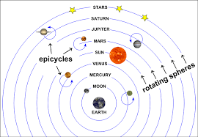
GEOCENTRIC MODEL OF UNIVERSE

Slide 9
COPERNICUS (1473 – 1543)
Sun centered universe (heliocentric)
Started what is known as the “Copernican Revolution” (the shift from geocentric to Heliocentric solar system)
Proposed that the planets rotate and revolve around the sun including Earth (first to propose that the Earth was moving)
explained retrograde motion is an illusion caused by the motion of Earth and these planets around the sun
While he held these beliefs for sometime, he waited until on his deathbed to publish his work On the Revolutions of the Heavenly Spheres

Slide 10
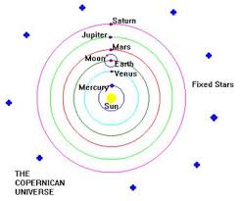
HELIOCENTRIC MODEL

Slide 11
TYCHO BRAHE (1546 – 1601)
Focused on an Earth centered universe and a sun centered universe and tried to merge them.
Used giant instruments to take the most accurate measurements to date.
Brahe was a teacher.

Slide 12
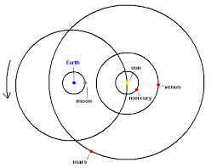
BRAHE’S MODEL

Slide 13
JOHANNES KEPLER (1571-1630)
Acquaintance of Tycho Brahe
Thought that there must be some explanation for why the 6 known planets were the distances they were.
Took Brahe’s measurements and came up with the three laws of planetary motion.

Slide 14
KEPLER’S LAWS OF PLANETARY MOTION
The planets move in elliptical orbits with the sun at a focus.
In their orbits around the sun, the planets sweep out equal areas in equal times.
The squares of the times to complete one orbit are proportional to the cubes of the average distances from the sun.

Slide 15
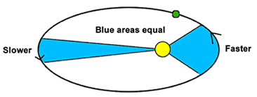
KEPLER’S SECOND LAW

Slide 16
GALILEO GALILEI (1564-1642)
Perfected the telescope: first to systematically use the telescope to collect observational space data.
Some of his discoveries include:
a. Venus goes through similar phases as the moon
b. sun is the central point of solar system
c. surface of the moon is rough
d. found Earthly characteristics on other planets

Slide 17
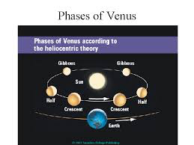
PHASES OF VENUS

Slide 18
ISAAC NEWTON (1642-1727)
Kepler’s work on planetary motion allowed Newton to formulate his laws of gravitation and laws of motion.
This leads to the modern day understanding of physics.
We have already covered these. Do you remember them?

